Slide 1
Analyzing the Marvel Cinematic Universe
Joseph Marinello

Slide 2
Project Goals
Marvel has recently achieved outstanding performance in the movie industry
Avengers: Endgame is the highest grossing movie of all time
The goal of this project is to analyze the social and commercial presence that they currently exhibit

Slide 3
Techniques Used
Text Mining
Sentiment Analysis
Map Visualization
Predictive Modeling
Shiny App Development

Slide 4
Text Mining
Search for 10,000 tweets containing “#Marvel”
7086 observations were collected
Focused around the United States
Individual tweet information was taken and manipulated for analysis
Converted all text to lower case
Removed punctuation
Removed numbers
Removed “English” stopwords

Slide 5
Text Mining
Frequency of words were calculated
Top 5 (sdcc, avengers, mcu, Spiderman, comics)
Top 5 superhero's (Spiderman, Thor, Xmen, Blade, Ironman)
Generated a word cloud of all the words

Slide 6
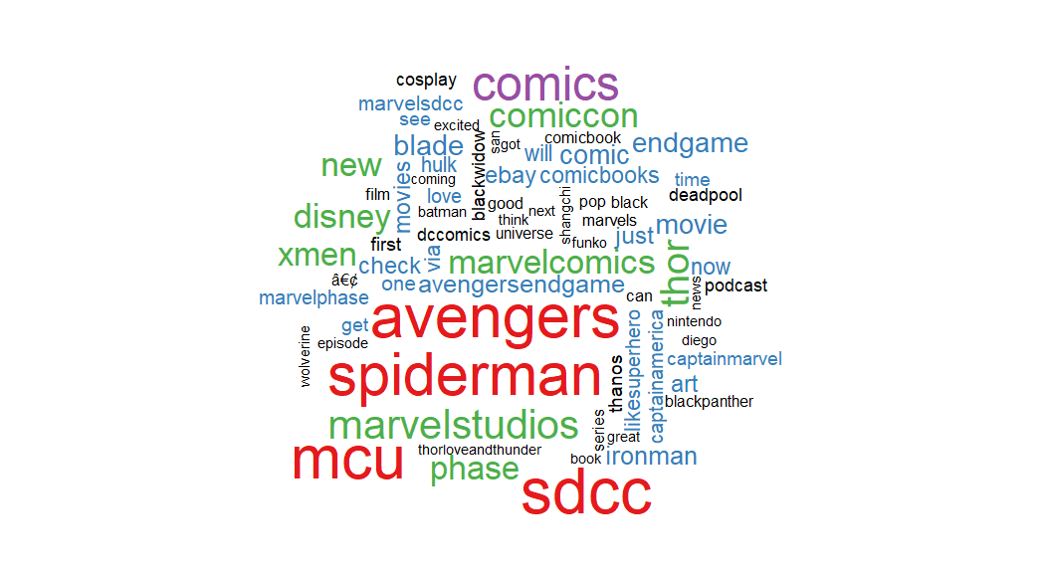
Marvel Tweets Word Cloud

Slide 7
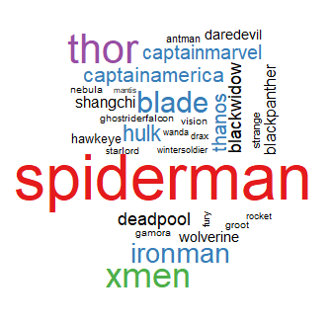
Text Mining
Frequency of specific characters
Marvel Character Word Cloud

Slide 8
Sentiment Analysis
Search tweets for positive and negative words
Poor performance from this technique
Many character names mimic both positive and negative sentiment
Marvel is seen throughout and considered positive
Strange, villains, fiction all considered negative
More time would need to be allocated towards sentiment analysis to get a useful idea of the sentiment to these tweets

Slide 9
Map Visualization
Using location data from the tweet observations
Geocode used to find latitude and longitude coordinates
Get_map and ggmap to visualize coordinates in a plot
Location data required extensive cleaning due to unreliability
Some users used custom “fake” locations
Most user’s had location data default to their state or city

Slide 10
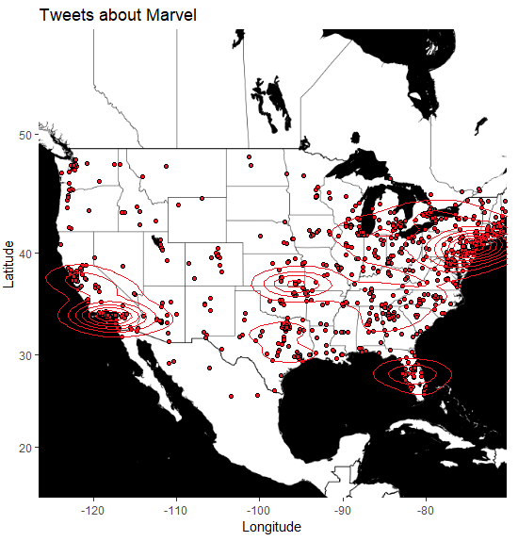

Slide 11
Tweet Analysis
Overall, not much has been learned from the tweet data
Insight on trending characters
Locations of interest
Poor sentiment analysis
Positive or negative connotation hard to distinguish

Slide 12
Predictive Modeling
Marvel movies are big money makers
Build a predictive model for potential earnings of a new movie based on data of all previous Marvel films
A realistic model will only be able to predict potential earnings based on Production Budget

Slide 13
Predictive Modeling
Dataset contains every mcu film
Data Includes:
Production Budget
Opening Earnings
Domestic Earnings
Foreign Earnings
Total Earnings
Profitability

Slide 14
Predictive Modeling
Split data into train and test set
Build Linear Model predicting Opening Earnings
Only predictive factor is Production Budget
Apply model to test data
Calculate error and RMSE value
Plot results visualizing error

Slide 15
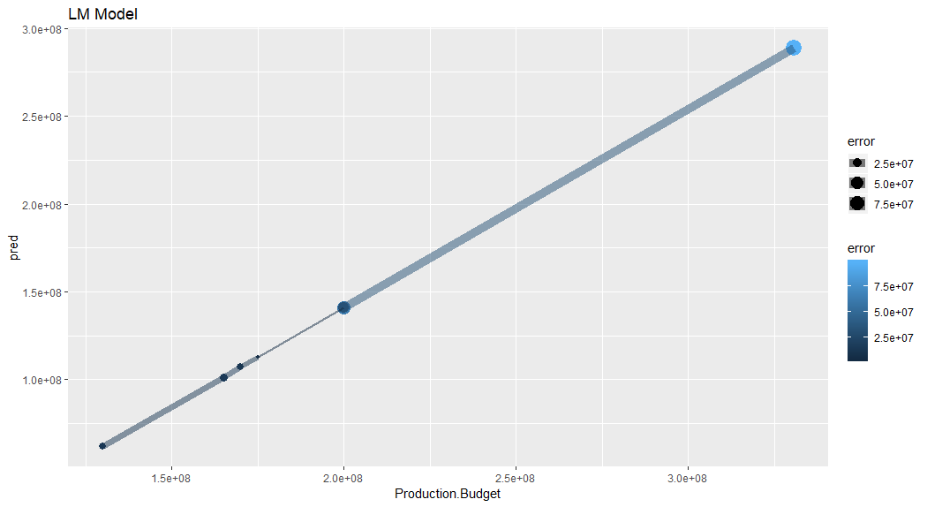

Slide 16
Shiny Application
Fully explore the MCU movie dataset
A simple scatterplot with a wide variety of user-changeable variables to gain insight on the data

